Slide 1
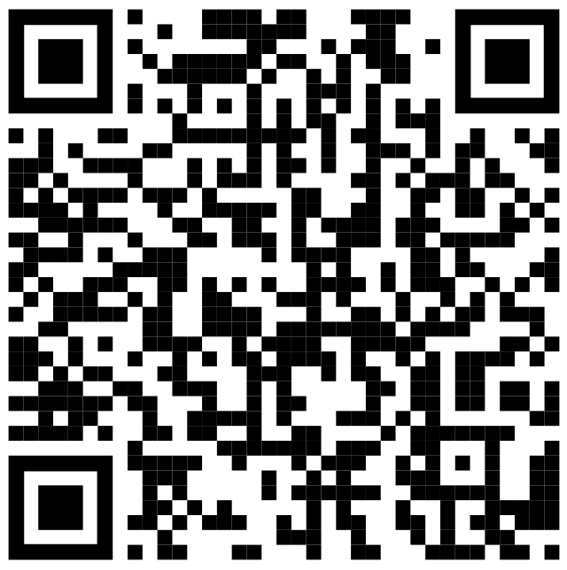
T-SQL - Beyond the Basics
Barney Lawrence

Slide 2
About Me

Slide 3
Why?

Slide 4
Content
SSMS Tips and Tricks
Common Table Expressions
Apply Operator
Window Functions
Pivoting
Unpivoting
Putting It All Together

Slide 5
SSMS - Options

Slide 6
SSMS - Custom Keyboard Shortcuts

Slide 7
SSMS – Alt Key

Slide 8
Common Table Expressions

Slide 9
APPLY

Slide 10
Window Functions

Slide 11
Pivoting

Slide 12
Unpivoting

Slide 13
Putting It All Together

